Slide 1
A Brief Introduction to
GAM
Adapted from Andre Punt’s
Fish 559, Lecture 23
Notes:
a

Slide 2
Linear regression &
additive modelling
Generalised linear
modelling & generalized
additive models
Allow for:
Nested data
Temporal correlation
Spatial correlation
Heterogeneity
Repeated measurement
Mixed modelling &
additive mixed modelling
Generalised linear mixed
modelling & generalised
additive mixed modelling
Zuur et al.; Fig. 15.1

Slide 3
Why GAMs Anyway?
A GAM is:
“a GLM in which part of the linear predictor is specified in terms of smooth functions of predictor values”
GLMs and GAMs have tended to become more similar in recent years (you can, for example, refer to splines when applying lm).

Slide 4
Why GAMs Anyway?
GAMs use a basis-expansion
i.e. X is transformed to yield smoothing covariates
Some GAMs also use a smoothing spline
Automatically estimates smoothness

Slide 5
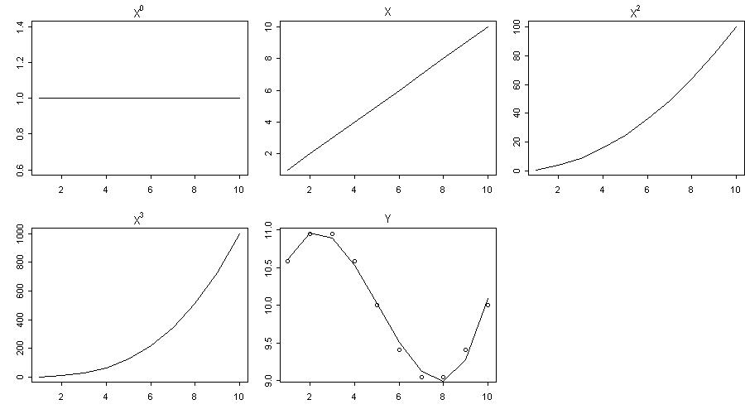
Polynomial basis expansion

Slide 6
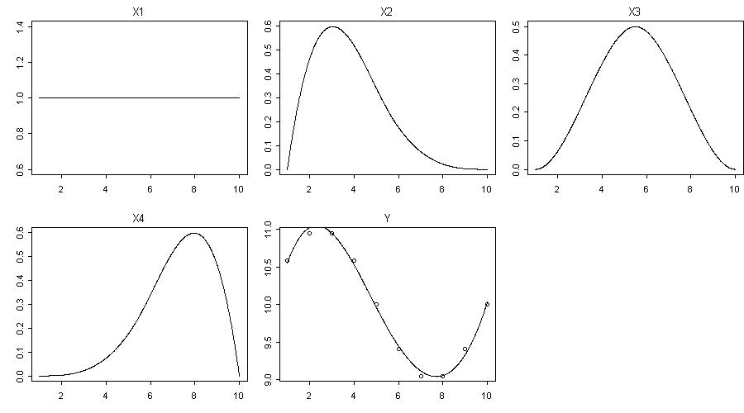
Cubic spline basis expansion

Slide 7
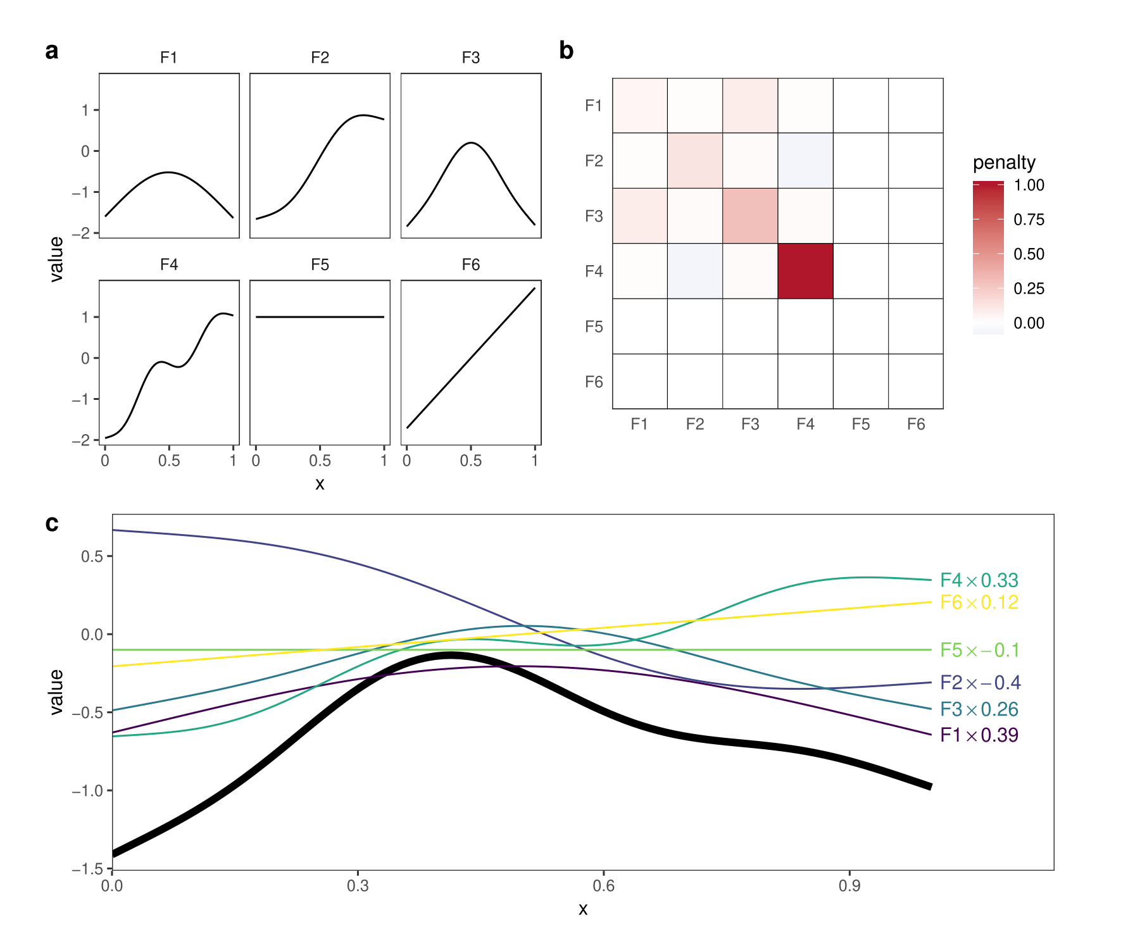

Slide 8
BackGround-I
Additive models are based on fitting a set of one-
dimensional smooth functions to the data. GAMs extend
smoothers (e.g. loess) [although loess is still useful when
conducting data exploration].
Output <- loess(y ~ x, span=y)

Slide 9
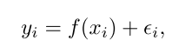
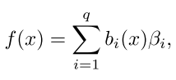
Background-II
In its simplest form a fixed-knot GAM is given by:
f(X_{i}) is a basis expansion for variable X_{i}

Slide 10
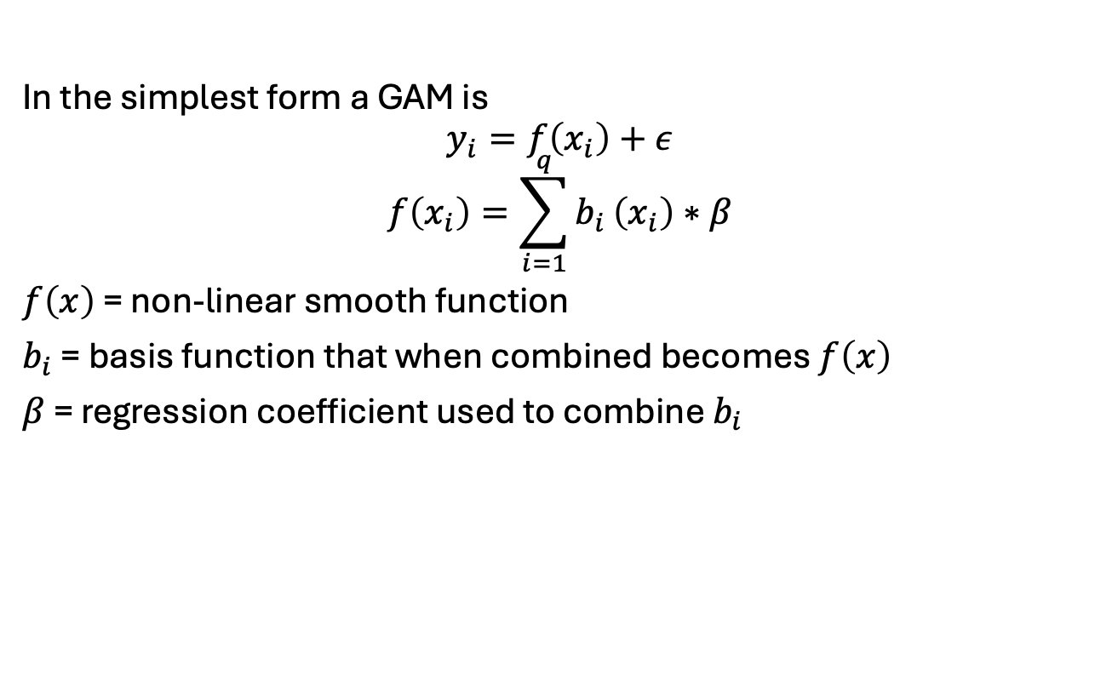
Background II

Slide 11
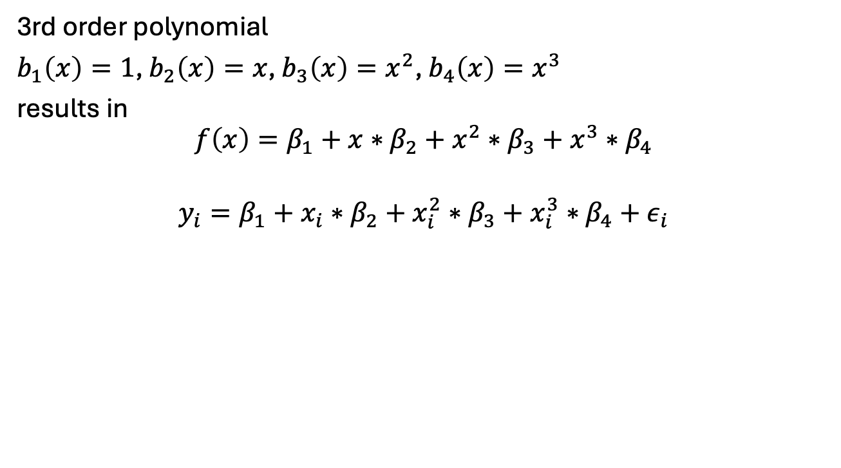
Polynomial basis (1)
3rd order polynomial
$b_{1}\left(x\right)=1$, $b_{2}\left(x\right)=x$, $b_{3}\left(x\right)=x^{2}$, $b_{4}\left(x\right)=x^{3}$
results in
$$f\left(x\right)=β_{1}+x∗β_{2}+x^{2}∗β_{3}+x^{3}∗β_{4}$$
$$y_{i}=β_{1}+x_{i}∗β_{2}+x_{i}^{2}∗β_{3}+x_{i}^{3}∗β_{4}+ε_{i}$$

Slide 12
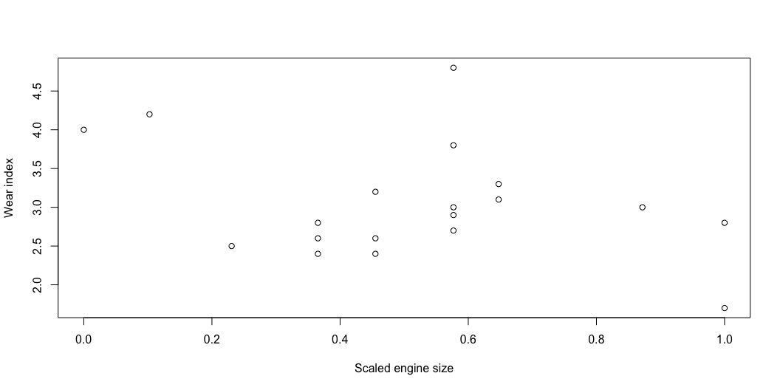
Generate data
Similar to a linear model??
# Generate data size<-c(1.42,1.58,1.78,1.99,1.99,1.99,2.13,2.13,2.13, 2.32,2.32,2.32,2.32,2.32,2.43,2.43,2.78,2.98,2.98) wear<-c(4.0,4.2,2.5,2.6,2.8,2.4,3.2,2.4,2.6,4.8,2.9, 3.8,3.0,2.7,3.1,3.3,3.0,2.8,1.7) x <- size - min(size) x <- x/max(x) # Plot plot(x, wear, xlab = "Scaled engine size", ylab = "Wear index")

Slide 13
Polynomial basis
Similar to a linear model??
# Fit model mod <- lm(wear ~ x + I(x^2) + I(x^3))

Slide 14
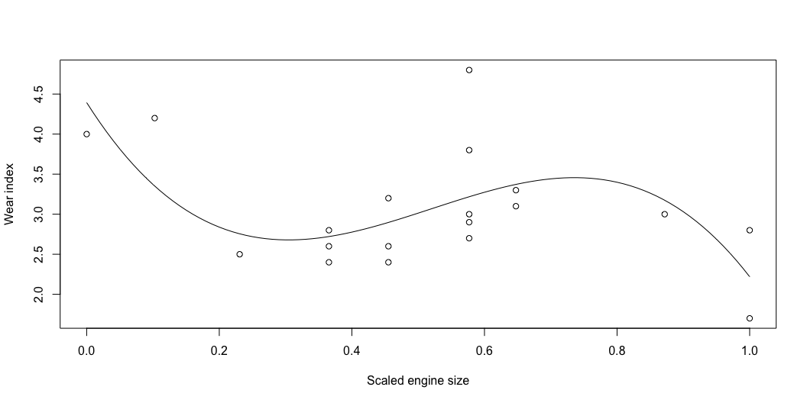
Plot polynomial basis
# Get beta b1 = mod$coefficients[1]; b2 = mod$coefficients[2]; b3 = mod$coefficients[3]; b4 = mod$coefficients[4]; # Plot plot(x, wear, xlab = "Scaled engine size", ylab = "Wear index") curve(b1 + x*b2 + x^2*b3 + x^3*b4, from = 0, to = 1, add = TRUE)

Slide 15
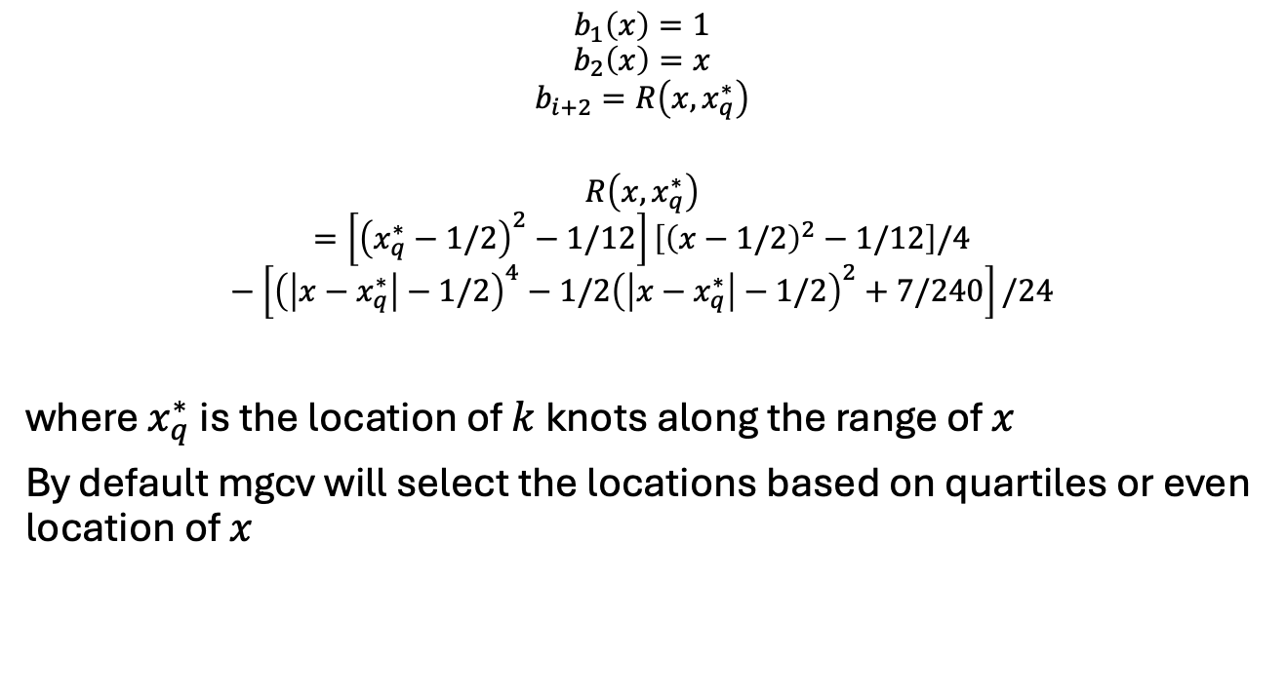
Cubic spline basis

Slide 16
Cubic spline basis in R by hand (1)
rk<-function(x,z){ # R(x,x*) for cubic spline on [0,1] ((z-0.5)^2-1/12)*((x-0.5)^2-1/12)/4- ((abs(x-z)-0.5)^4-(abs(x-z)-0.5)^2/2+7/240)/24 } spl.X <-function(x, xk){ # setup model matrix q <- length(xk)+2 # number of parameters n <- length(x) # number of data X <- matrix(1, n, q) # initialized model matrix X[, 2] <-x # set second column to x X[,3:q]<-outer(x,xk,FUN=rk) # and remaining to R(x,xk) X }

Slide 17
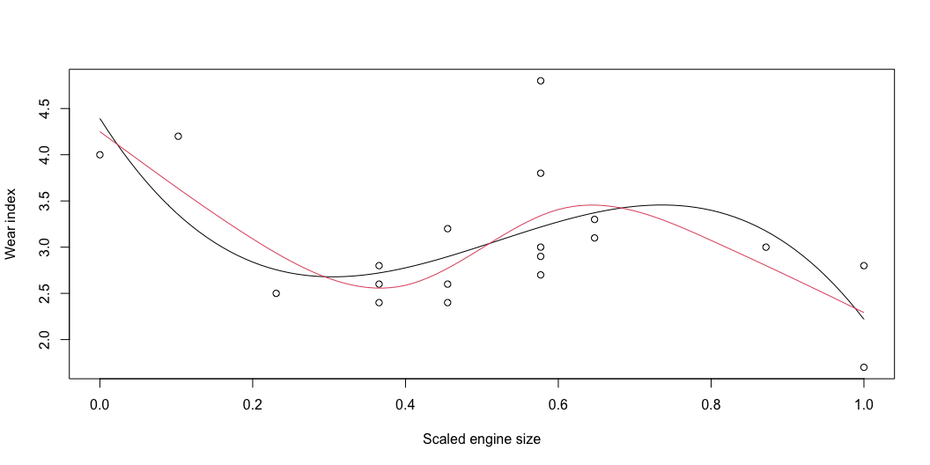
Cubic spline basis in R by hand (2)
xk <- 1:4/5 # choose location of 4 knots Xmat <- spl.X(x, xk) # generate model matrix mod.1 <- lm(wear ~ Xmat - 1) # fit model xp <- 0:100 / 100 # x values for prediction Xp <- spl.X(xp, xk) # prediction matrix # Plot plot(x, wear, xlab = "Scaled engine size", ylab = "Wear index") lines(xp, Xp %*% coef(mod.1)) # plot fitted spline

Slide 18
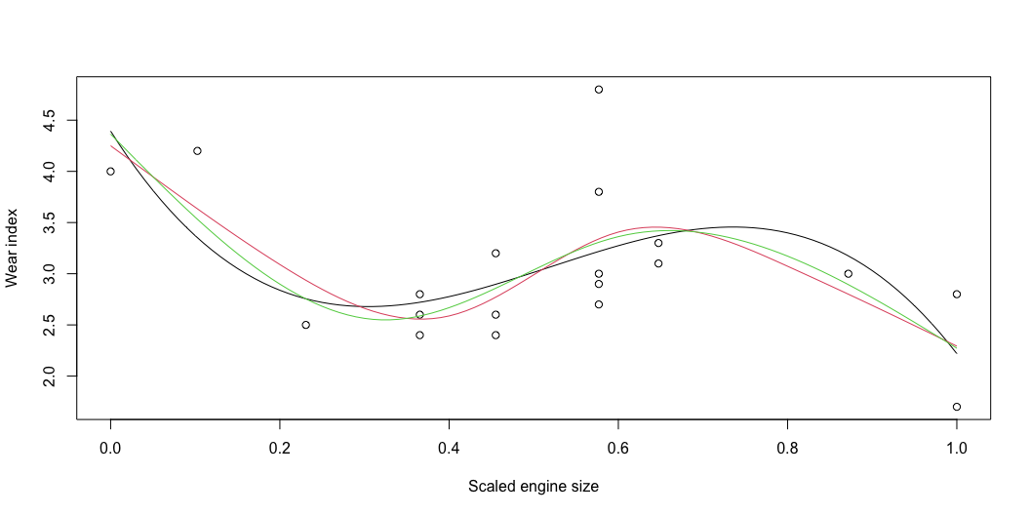
Cubic spline basis in R mgcv
# Fit GAM library(mgcv) mod.2 <- gam(wear ~ s(x, k = 4, bs = "cr", m = 2), gamma = -1) # fit model with 4 knots predy <- predict(mod.2, newdata = data.frame(x = xp), type = "response") # Plot plot(x, wear, xlab = "Scaled engine size", ylab = "Wear index") lines(xp, Xp %*% coef(mod.1)) # plot fitted spline lines(xp, predy, col = 2)

Slide 19
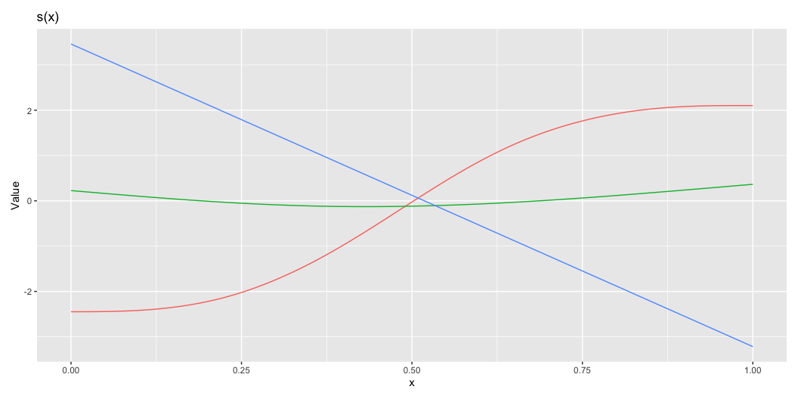
Basis functions
library(gratia) library(dplyr) basis(mod.2) %>% draw()

Slide 20
Background-III
Smooth splines use an additional penalty on spline coefficients
EDF: effective degrees of freedom
Calculated using Trace(Β)
Rescaled AIC

Slide 21
GAM Packages
GAM implementations
gam in gam: not recommended
gam in mgcv: contains more of what we need
GAMM implementations
gamm in mgcv: uses nlme package
gamm4 in lme4: uses lme4 package

Slide 22
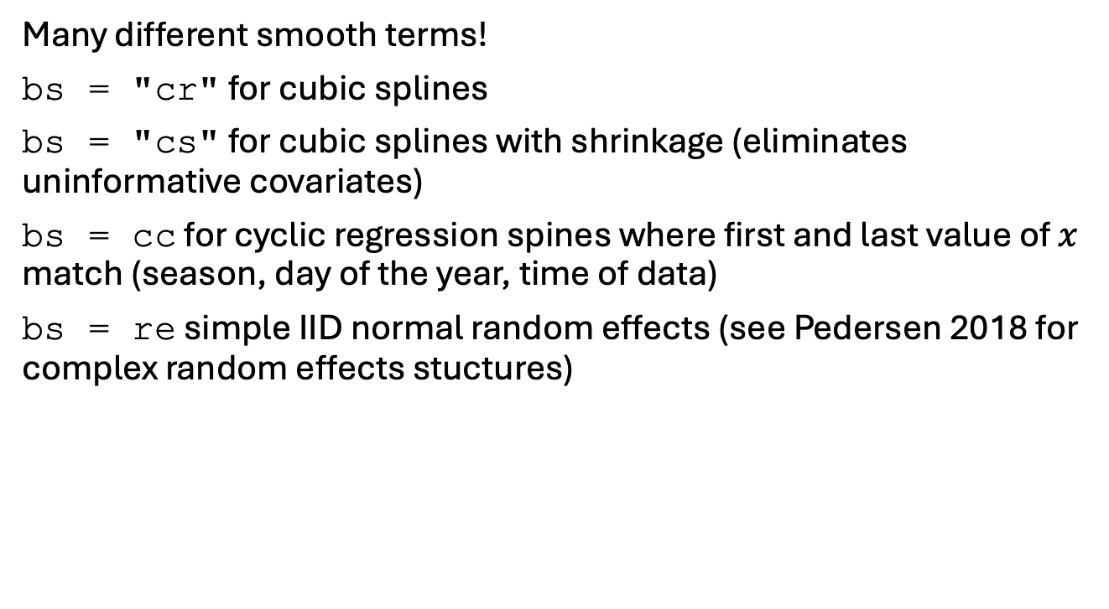
Basis functions

Slide 23
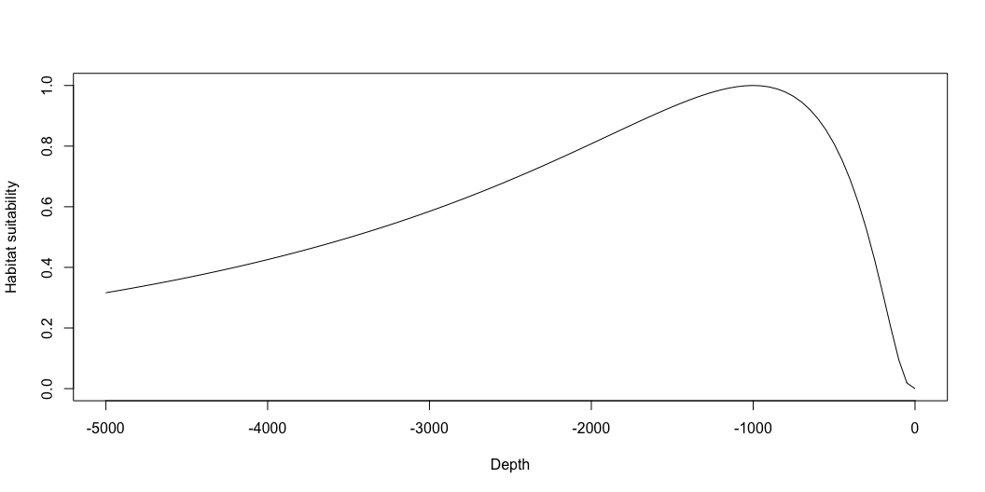
1D models
GAMs are great at approximating non-linear functions
Remember our simulated survey data?

Slide 24
1D models
GAMs can be used to fit to the survey data and approximate the curve:
source("Simulate_Spatial_Data_No_Plots.R") library(mgcv) gm.1 <- gam(CPUE ~ s(Depth, k = 10) + as.factor(Year), data = haul_data, family = poisson, select = TRUE)

Slide 25
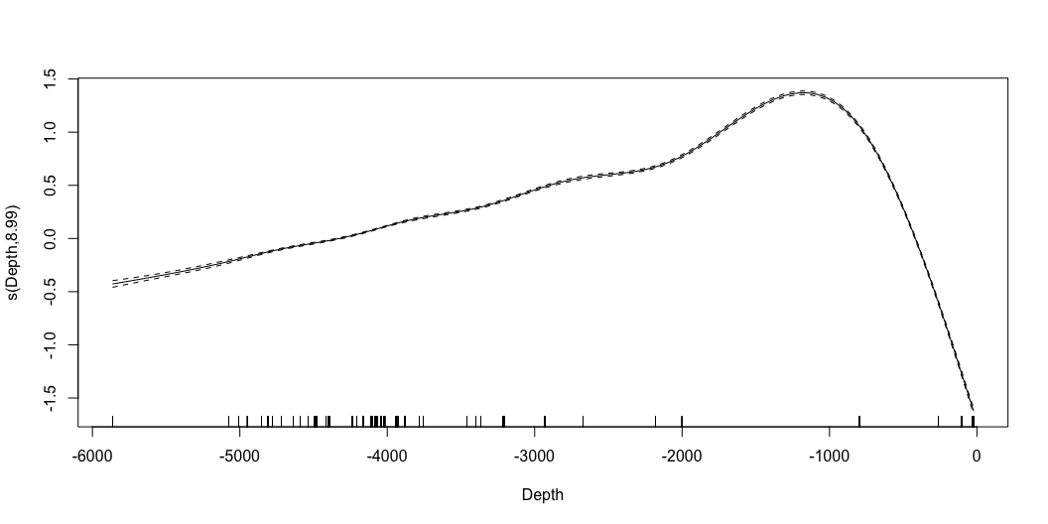
1D models
GAMs can be used to fit to the survey data and approximate the curve:
source("Simulate_Spatial_Data_No_Plots.R") library(mgcv)
gm <- gam(CPUE ~ s(Depth, k = 10) + as.factor(Year), data = haul_data, family = poisson, select = TRUE) plot(gm)

Slide 27
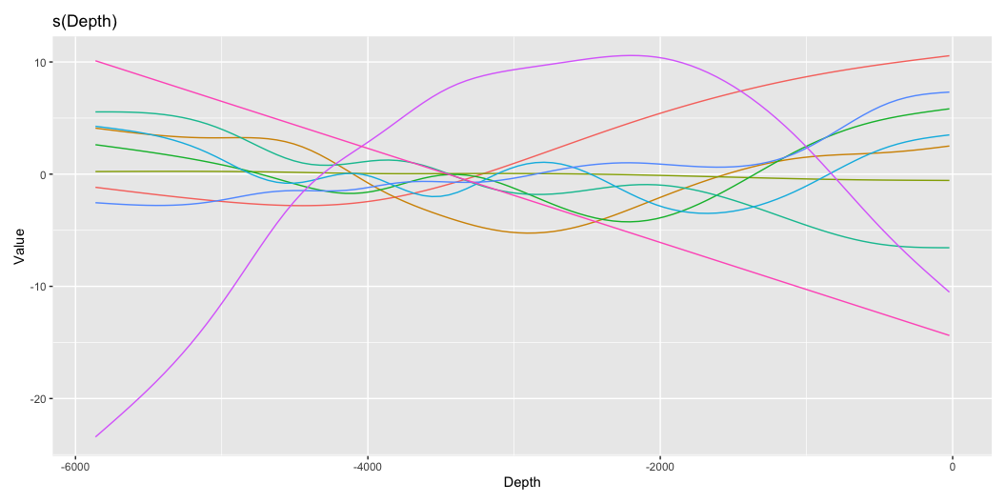
Plot partial smooths
library(gratia) basis_weights <- smooth_coefs(gm.1, select = "s(Depth)") basis(gm.1) %>% draw()

Slide 28
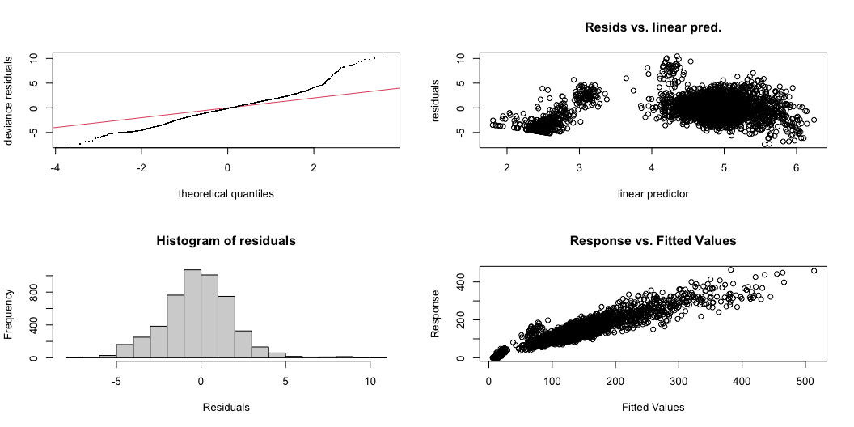
Diagnostics
gam.check(gm.1)

Slide 29
Method: UBRE Optimizer: outer newton full convergence after 14 iterations. Gradient range [1.053228e-07,4.660583e-06] (score 3.359395 & scale 1). Hessian positive definite, eigenvalue range [1.086195e-07,9.449816e-06]. Model rank = 59 / 59 Basis dimension (k) checking results. Low p-value (k-index<1) may indicate that k is too low, especially if edf is close to k'. k' edf k-index p-value s(Depth) 9 9 0.48 <2e-16 *** --- Signif. codes: 0 '***' 0.001 '**' 0.01 '*' 0.05 '.' 0.1 ' ' 1

Slide 30
Example from Zuur-I
Data on pelagic bioluminascence
versus depth for “cruise 16”
(source: Zuur et al.)
This function is not linear and
there may be “something” at
1500m

Slide 31
Example from Zuur-II
M3 <- gam(Sources16 ~ s(Depth16,fx=FALSE, k=-1,bs="cr"))
plot(M3,se=TRUE)
s = smoothing spline
fx = use cross validation to
select the number of
degrees of freedom
cr = cubic regression spline

Slide 32
Example from Zuur-III
Predicted fit
(using predict)

Slide 33
Model Selection (for Knots)
I used XX$aic to extract
the AIC

Slide 34
Multiple predictors-I
Moving to multiple predictors (a spline and a factor):
M4 <- gam(So ~ s(De) + factor(ID), subset = I1)

Slide 35
Multiple predictors-II
Family: gaussian Link function: identity
Formula:
So ~ s(De) + factor(ID)
Parametric coefficients:
Estimate Std. Error t value Pr(>|t|)
(Intercept) 19.198 1.054 18.207 < 2e-16 ***
factor(ID)13 -12.296 1.397 -8.801 7.59e-13 ***
---
Signif. codes: 0 ‘***’ 0.001 ‘**’ 0.01 ‘*’ 0.05 ‘.’ 0.1 ‘ ’ 1
Approximate significance of smooth terms:
edf Ref.df F p-value
s(De) 4.849 5.349 16.19 7.47e-11 ***
R-sq.(adj) = 0.695 Deviance explained = 71.9%
GCV score = 38.802 Scale est. = 35.259 n = 75
Formula
Parameter estimates
Explained variance, etc.

Slide 36
Diagnostics
vis.gam(M4,theta=120,color="heat")
gam.check(M4)

Slide 37
Multiple Predictors III
GAM terms are additive so
one can plot each in turn.
However, making predictions
of surfaces (over all covariates)
is often more meaningful

Slide 38
Interactions-I
Interactions among variables can be important to capture
non-linear effects which are not easy to capture using
single variable models.
The number of options, however, to get large:
From Wood (2006)
m2 <- gam(medFPQ~s(Y,X,k=100),data=brain,
family=Gamma(link=log),method=gm)

Slide 39
Interactions-II
vis.gam(m2,plot.type="contour",
too.far=0.03,color="gray",n.grid=60,zlim=c(-1,2))

Slide 40
Output
Su et al. 2009 Fish. Ocean

Slide 41
Spatial models
GAMs are great for spatial modelling
Using interactions

Slide 42
Simulated survey data
gm.2 <- bam(CPUE ~ ti(X, Y, k = c(15, 15)),
data = haul_data_random,
family = poisson,
select = TRUE)

Slide 43
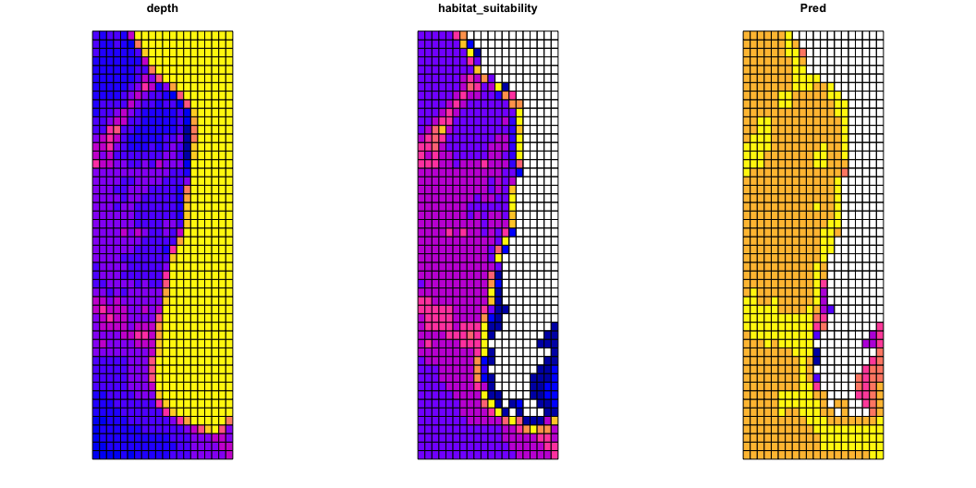
# Predict distribution pred <- data.frame(X = polygony$X, Y = polygony$Y) pred$pred <- predict(gm.2, pred) # Plot polygony <- polygony %>% dplyr::mutate(Pred = pred$pred) plot(polygony[c("depth", "habitat_suitability", "Pred")])

Slide 44
Mackerel egg survey
Borchers et al. (1997) sampled eggs of mackerel to understand their spatial distribution and relation to environmental predictors.
library(mgcv) library(gamair) data("mack") mack$log.net.area <- log(mack$net.area) gm <- gam(egg.count ~ s(lon, lat) + offset(log.net.area), data = mack, family = nb, control = gam.control(maxit=100))

Slide 45
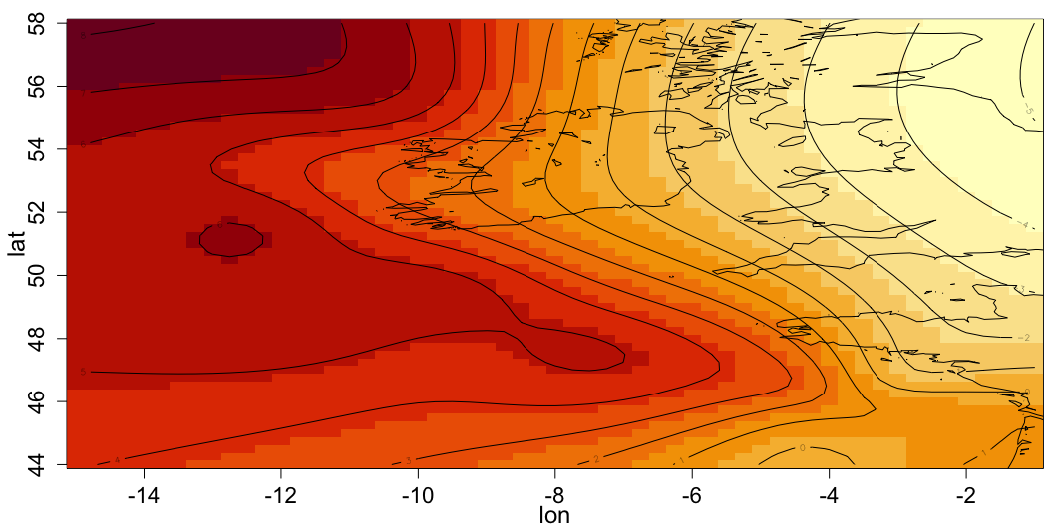
# Coastline data("coast") # Predict distribution lon = seq(-15, -1, by = 0.25) lat = seq(44, 58, by = 0.25) pred <- expand.grid(lon = lon, lat = lat) pred$log.net.area <- 0 pred$pred <- predict(gm, pred) # Plot par(mar = c(3,3.5,1,0.5), mgp = c(2,1,0)) image(lon, lat, matrix(pred$pred, 57, 57), cex.lab=1.5, cex.axis=1.4) contour(lon, lat, matrix(pred$pred, 57, 57), add = TRUE) lines(coast$lon, coast$lat, col=1)

Slide 46
Problems?

Slide 47
Problems?
Can use soap film smoothers to account for coastlines and islands
bs = "so"

Slide 48
Random effects approach
Integrate over space for indices
https://pbs-assess.github.io/sdmTMB/

Slide 49
Extension to MM
GAM can be extended to GAMM in the same way (more or less)
that GLM can be extended to GLMM. However, as mentioned
before, the packages for GLMM and GAMM are under
development and the methods are necessarily approximate.
Therefore, be somewhat wary of AIC, BICs and p-values.

Slide 50
An example (from Zuur)
The Roulin and Bersier dataset is based on the begging
behaviour of owls. A number of nests were visited multiple
times and the number of calls just before the arrival of a
parent was recorded. There may be number chicks in a nest.
The data are in dataset Owls.txt.
Logically, we should consider the data to be Poisson-distributed.
I will consider a simple formulation of the problem with
“Foodtreament” and “Arrivaltime” as the only covariates.

Slide 51
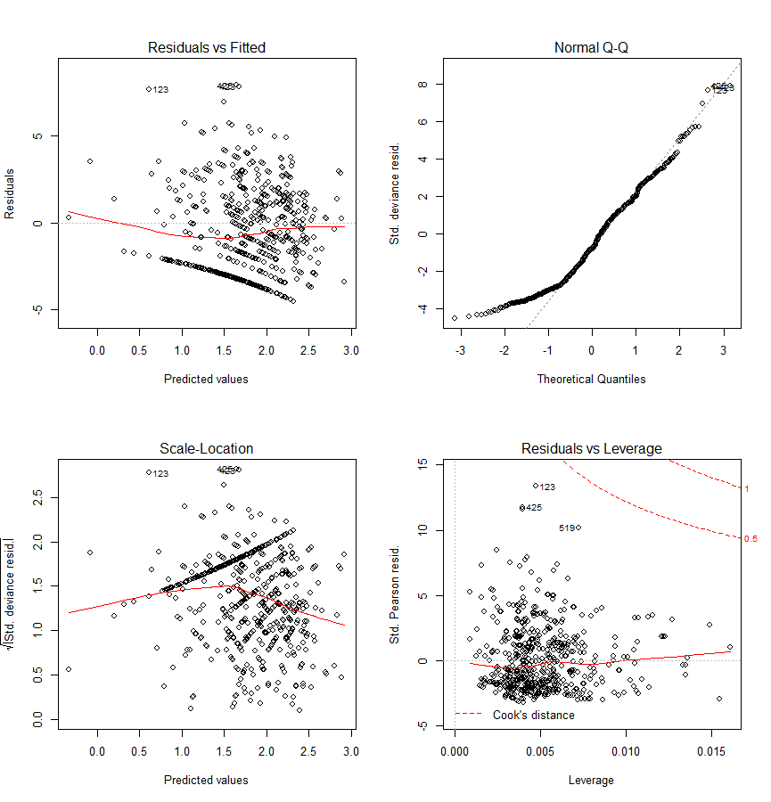
Attempt I – A Poisson GLM
# Poisson GLM
Case1 <- glm(NCalls ~ offset(LBroodSize)+FoodTreatment+ArrivalTime,data=Owls family=poisson)
print(summary(Case1))
par(mfrow=c(2,2))
plot(Case1)
Why was this apriori a
bad way to model these data?

Slide 52
Attempt II – A Poisson GLMM
# Poisson GLMM
Case2 <- lmer(NCalls ~ offset(LBroodSize)+FoodTreatment+ArrivalTime + (1|fNest),data=Owls,family=poisson)
print(summary(Case2))
par(mfrow=c(2,2))
plot(Case2)
Better: Note that some of the results differ from those
in Zuur et al.!

Slide 53
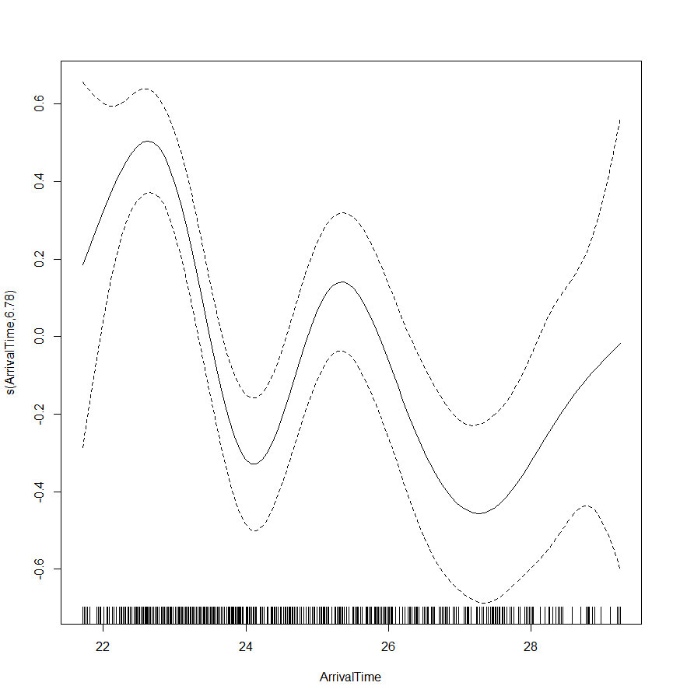
Attempt II – A Poisson GAMM
library(mgcv)
Case3<-gamm(NCalls~offset(LBroodSize)+FoodTreatment+s(ArrivalTime),random=list(fNest=~1),data=Owls,family=poisson)
summary(Case3$gam)
anova(Case3$gam)
plot(Case3$gam)

Slide 54
Call to GAMM
Fixed effects structure
Random effects structure
Correlation structure for the residuals
gamm(formula,random=NULL,correlation=NULL,family=gaussian(), data=list(), weights=NULL, subset=NULL, na.action, knots=NULL, control=list(niterEM=0,optimMethod="L-BFGS-B"), niterPQL=20,v erbosePQL=TRUE, method="ML",...)
Random components are specified as a list:
random=list(x=~1, y=~1,z=~1+life)

Slide 55
Predictions From GAMM
Use predict to make predictions using a fitted gamm model
Set to response for response on the scale of data
Note this defaults to FALSE
predict(object,newdata,type="link",se.fit=FALSE,terms=NULL, block.size=1000,newdata.guaranteed=FALSE,na.action=na.pass, unconditional=FALSE,...)

Slide 56
GAMM4
gamm4 in library gamm4 is an alternative to gamm which
should / may be more robust.
Gamm4 has a different way to specify random effects:
gamm4(y ~ s(x),random = ~ (x+0|g) + (1|g) + (1|a/b))
Nested random effects

Slide 57
References
There are plenty:
Crawley. 2003. Statistical Computing: An Introduction to Data Analysis using S-Plus
Venables and Ripley. 1994. Modern Applied Statistics with S-PLUS.
Venables and Dichmont. 2004. Fish. Res. 70: 409-426
Wood. 2006. Generalized Additive Models: An Introduction with R
Zuur et al. 2009. Mixed Effects Models and Extensions in Ecology R
Hastie, T., Tibshirani, R. and Friedman, J. 2009. The Elements of Statistical Learning: Data Mining, Inference, and Prediction, Second Edition.
Available for free here: http://www-stat.stanford.edu/~tibs/ElemStatLearn/

